Slide 1
Learning how to learn & learn fast
Binh Nguyen

Slide 2
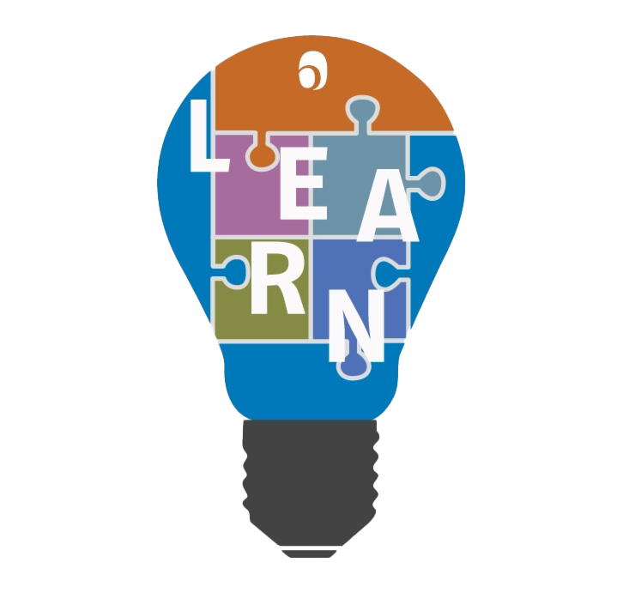
Agenda
- How to learn a new thing
- Learn a fast way

Slide 3
How to learn a new thing
Research
Create a roadmap
Start with the basics
Follow a structured approach
Practice actively
Seek guidance
Review and recap:
Stay consistent and motivated

Slide 4

Research
Use various tools such as books, articles, online resources, or courses to gather information about your chosen subject. Understand the key concepts, terminology, and any related background knowledge.

Slide 5
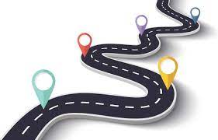
Create a Road Map
Organize your learning into a step-by-step plan. Break down the subject into smaller topics or sub-skills that you need to cover. Arrange them in an order that makes sense and builds upon previous knowledge.

Slide 6

Start with the basics:
Begin with the foundational knowledge or skills of the subject. Lay a strong groundwork that will support more advanced learning.

Slide 7

Follow a structured approach
Progress through your roadmap systematically, giving equal attention to each step. Take one step at a time and master it before moving on to the next. This builds a solid foundation and prevents overwhelm.

Slide 8
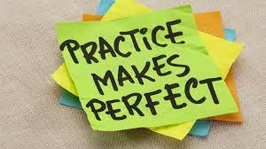
Practice actively:
Work on applying what you learn through practice, exercises, or projects. Engage in hands-on activities that allow you to use and deepen your understanding of the subject.

Slide 9

Seek guidance:
Reach out to experts, instructors, or mentors who can provide guidance, clarify doubts, and offer feedback. They can accelerate your learning journey by correcting mistakes and sharing valuable insights.

Slide 10

Review and recap:
Regularly revisit what you have learned to reinforce your knowledge. Reflect on your progress, identify any gaps, and revise or practice accordingly.

Slide 11

Stay consistent and motivated:
Make learning a regular habit by scheduling dedicated time for it. Additionally, find ways to stay motivated, such as setting goals, tracking progress, celebrating milestones, or finding a study buddy or community with similar interests.

Slide 12
How to learn a fast way?
Set clear goals
Break it down
Prioritize
Find reliable resources
Teach others
Implement active learning techniques

Slide 13

Set clear goals
Define what you want to learn and why. Having a clear objective will help you stay focused and motivated.

Slide 14

Break it down:
Divide the subject or skill you want to learn into smaller, manageable sections. This will make it easier to concentrate on one aspect at a time.

Slide 15

Prioritize:
Identify the most important elements that need to be mastered first. Focus on these fundamental building blocks before moving on to more complex concepts.

Slide 16

Find reliable resources:
Choose quality learning materials such as textbooks, online courses, or video tutorials. Seek recommendations from experts or people who have already achieved expertise in the field.

Slide 17

Teach others:
Teaching or explaining what you've learned to someone else can reinforce your understanding of the subject. It also helps you fill in any knowledge gaps you may have.

Slide 18
Thank you
Binh Nguyen

